Slide 1

Smart Property & Accommodation Management System
Project Proposal – ENEL2SEH2 PROJECT

Slide 2

Table of Content
Executive Summary
Objectives
Scope of Work
Project Timeline
Budget Estimate
Team Overview
Terms and Conditions
Conclusion

Slide 3
Executive Summary
The Smart Property & Accommodation Management System is a web and mobile application designed to simplify the process of finding, booking, renting, and managing different types of properties. The system combines features commonly found in platforms such as Airbnb, Booking.com, Property24, and student accommodation services into one centralized application.
The application will serve multiple stakeholders, including customers, property owners, and administrators. Customers will be able to search for available properties, book viewings, reserve accommodation, make secure deposit payments, leave reviews, and view property locations using Google Maps. Property owners will have access to tools for listing properties, uploading photos, managing bookings, monitoring revenue, and responding to maintenance requests. Administrators will oversee user management, property approvals, reporting, and system statistics. The proposed system aims to improve efficiency, increase transparency, and provide a convenient digital solution for the South African property and accommodation market.

Slide 4

Objectives
The objectives of the Smart Property & Accommodation Management System are to:
Develop an online platform that combines accommodation booking and property management services.
Provide users with a simple and secure property search and booking experience.
Allow property owners to efficiently manage their properties and bookings.
Enable administrators to manage users, approve listings, and generate reports.
Improve communication between tenants and property owners through maintenance request management.
Promote secure transactions and improve customer satisfaction

Slide 5
Scope of Work
In Scope :
A login system for two user types: client and administrator.
An administrator interface for adding, editing and removing fictional property listings.
A client interface for viewing and searching available properties.
A booking or viewing-request form where the client selects a property and preferred date.
An administrator interface for approving, rejecting or cancelling requests.
A linked database for storing users, properties and booking or viewing requests.
Basic availability checking to prevent conflicting approved bookings.
A simple summary report showing properties and booking-request statuses.
System Design:
Design the user interface (UI/UX).
Create system architecture.
Design the database structure.
Develop UML diagrams (Use Case, Class, Activity, ER Diagram).

Slide 6
Scope of Work
Development:
Develop the core features of the system, including:
Customer registration and login.
Property search and booking.
Property owner dashboard.
Property listing and photo upload.
Booking and reservation management.
Reviews and ratings.
Admin dashboard.
Maintenance request management.

Slide 7
Scope of Work
Testing:
Perform unit testing.
Conduct system and integration testing.
Fix identified bugs and errors.
Test security, performance, and usability.
Deployment:
Deploy the application to the production server.
Configure the database and hosting environment.
Verify all modules are functioning correctly.
Launch the system for end users.

Slide 8
Scope of Work
Support and Training:
Train administrators and property owners on how to use the system.
Provide user manuals and documentation.
Offer technical support during the initial deployment period.
Monitor the system and resolve any post-deployment issues.

Slide 9
Scope of Work
Out Of Scope for Initial Prototype
Direct booking of real properties owned by external landlords or accommodation providers.
Real financial transactions or processing of actual rental payments.
Legal verification of tenants, landlords, leases or uploaded documents.
Automatic credit checks, background checks or tenant screening.
Physical property inspections and maintenance work management.
Integration with external property websites, banks or government systems.
Mobile application development; the project will focus on a desktop-based prototype.
Use of real personal, financial or property records. Demonstration data will be fictional.
Full commercial deployment, public hosting or use by an actual property agency.

Slide 10
Project Timeline
Phase
Duration
Phase 0: Proposal draft and topic approval request
Phase 1: Chapter 1 & 2 – Introduction, requirements and background
Phase 2: Chapter 3 & 4: analysis, design and Documentation
Phase 3: Designing System modules and interfaces
Review: Submit phases 1-3 for lecturer review
Phases 4-5: Writing programs and building prototype demo
Phase 6-7: Testing, evaluation and review
Phase 8: Final report submission
Phase 0: Week 1 – 1 week
Phase 1: Week 2 – 2 weeks
Phase 2: Week 4 – 2 weeks
Review: Week 4 ~ 1 week
Phases 4-5: Week 6 – 5 weeks
Phase 6-7: Week 11 – 2 Weeks
Phase 8: Week 13 ~1 Week - Submission

Slide 11
Budget Estimate
Cost(Rands)
Items
R0
R0
Variable
Low
Low
Software tools and IDEs
Database and Libraries
Internet and Communication
Optional Printing
Contingency
Overall estimate: software licensing cost is expected to remain minimal because the proposed prototype can be built using free development tools and open-source technologies.
KEY RESOURCES REQUIRED
Team coordination and regular progress tracking.
Reliable laptop access for design, coding and testing.
Stable database structure before implementation begins.
Shared folder/repository for documents, diagrams and source code.
Time management due to overlapping module workload.

Slide 12
Team Overview
Samukelo Jili
225004064
Siyavuya Mkhize
225110145
Sphumelele Ngidi
225006095
Lihle Nkomo
225163975
Wandile Zuke
225024142

Slide 13
Terms and Conditions
Project duration is approximately 11 weeks. Changes outside the agreed scope may require additional time and cost.
Project decisions will be made collectively by the team.
The proposal is for lecturer approval of the chosen topic before full development begins.
User information will be handled securely and confidentially. .
Free/open-source tools will be prioritized where possible.
User Acceptance Testing (UAT) must be completed before final deployment.
The scope may be refined after feedback, provided the core software engineering requirements remain satisfied.
All documentation and software produced will be original work unless otherwise referenced.

Slide 14
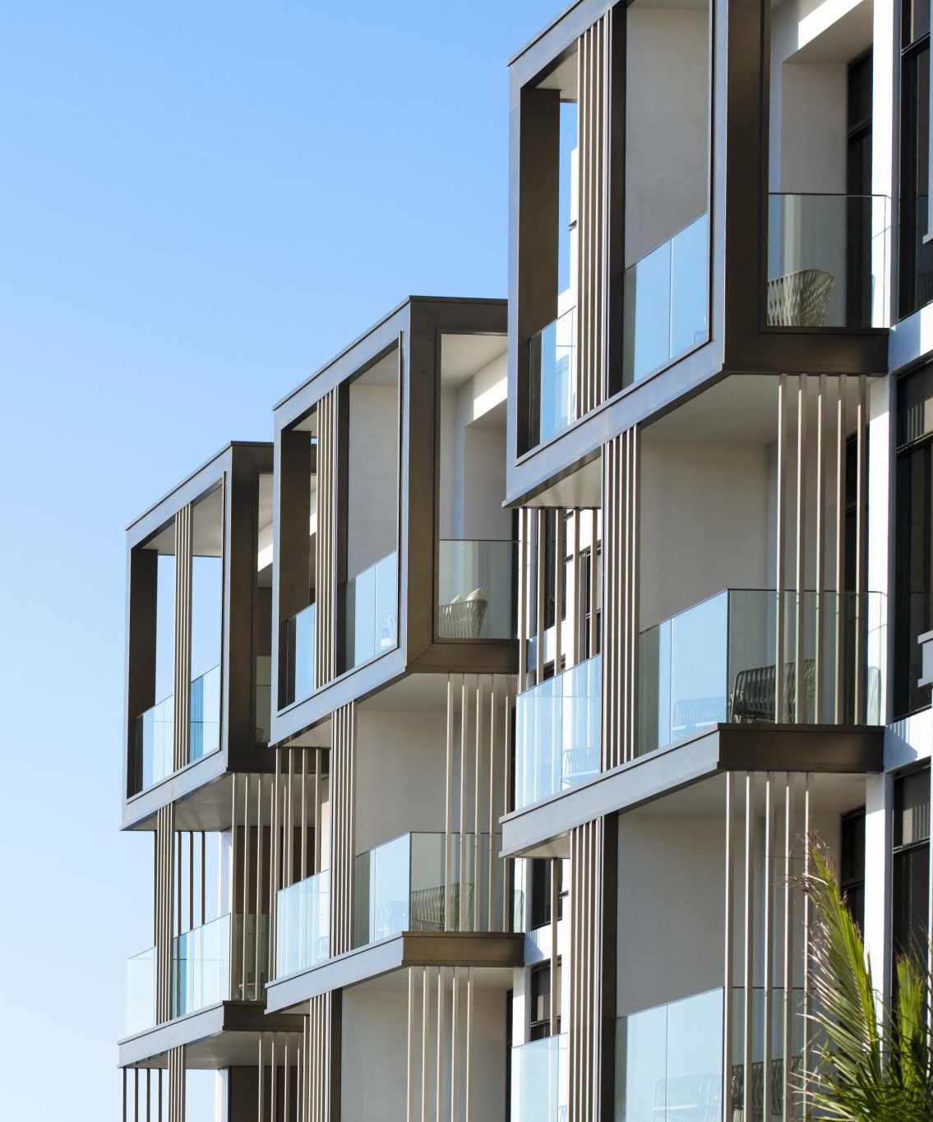
Conclusion
The Smart Property & Accommodation Management System is designed to modernize the way accommodation and property services are managed by bringing multiple property-related functions into one integrated platform. By supporting student residences, apartments, holiday homes, guest houses, hotels, rental properties, and offices, the system provides a comprehensive solution for both property owners and customers.
With features such as online property browsing, booking management, secure payments, reviews, maintenance request tracking, and administrative reporting, the proposed system will improve efficiency, reduce manual processes, and enhance the overall user experience. This project has strong potential within the South African market, where demand for reliable accommodation and property management solutions continues to grow. Once implemented, the platform will offer a scalable, secure, and user-friendly solution that benefits tenants, property owners, and administrators alike.

